Slide 1
The Assignment problem
Brandon roos, Nathan Price, Nathan Blunkall

Slide 2

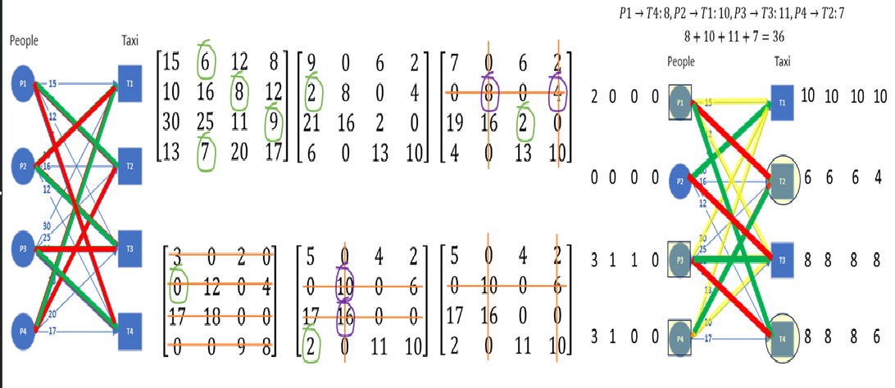
What is the Assignment problem?
The Assignment Problem describes the problem of assigning x number of agents to y number of tasks while incurring the lowest total cost possible. The Assignment Problem mainly uses a cost matrix or a bipartite graph as input and has many different algorithms to solve it.

Slide 3
What is the Assignment problem used for?
Personnel Scheduling
Task Assignment
Self Driving Cars
Facility Location and Workforce Planning

Slide 4
Solutions to the Assignment problem
Brute Force
Greedy
Hungarian
Max Flow Reduction

Slide 5
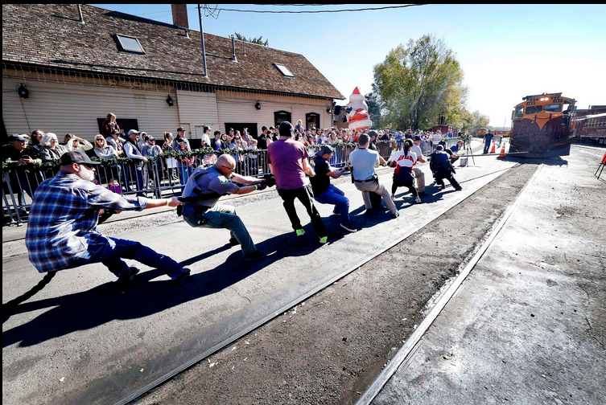
Pros and Cons of the Brute Force Solution
Pros:
Easy to implement
Guaranteed to find the optimal solution
Cons:
O(n!) running time
Only works for small problems due to its inefficiency

Slide 6
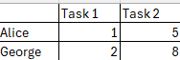

Pros and Cons of the Greedy solution
Pros:
Easy to implement
O(n*log(n)) running time
Cons:
Can pick suboptimal solutions
Only works for specific problems

Slide 7

Pros and Cons of the Hungarian solution
Pros:
Guaranteed to find the optimal solution
O(n^3) running time
Can handle infeasibility
Cons:
Harder to implement than the Greedy and Brute Force solutions
Requires a balanced cost matrix to work
Limited flexibility

Slide 8

Pros and Cons of the Max Flow solution
Pros:
Guaranteed to find the optimal solution
O(n^3) running time
Can be used to solve many variations of the assignment problem
Cons:
Hardest algorithm to implement
Only optimal for large complex problems

Slide 9
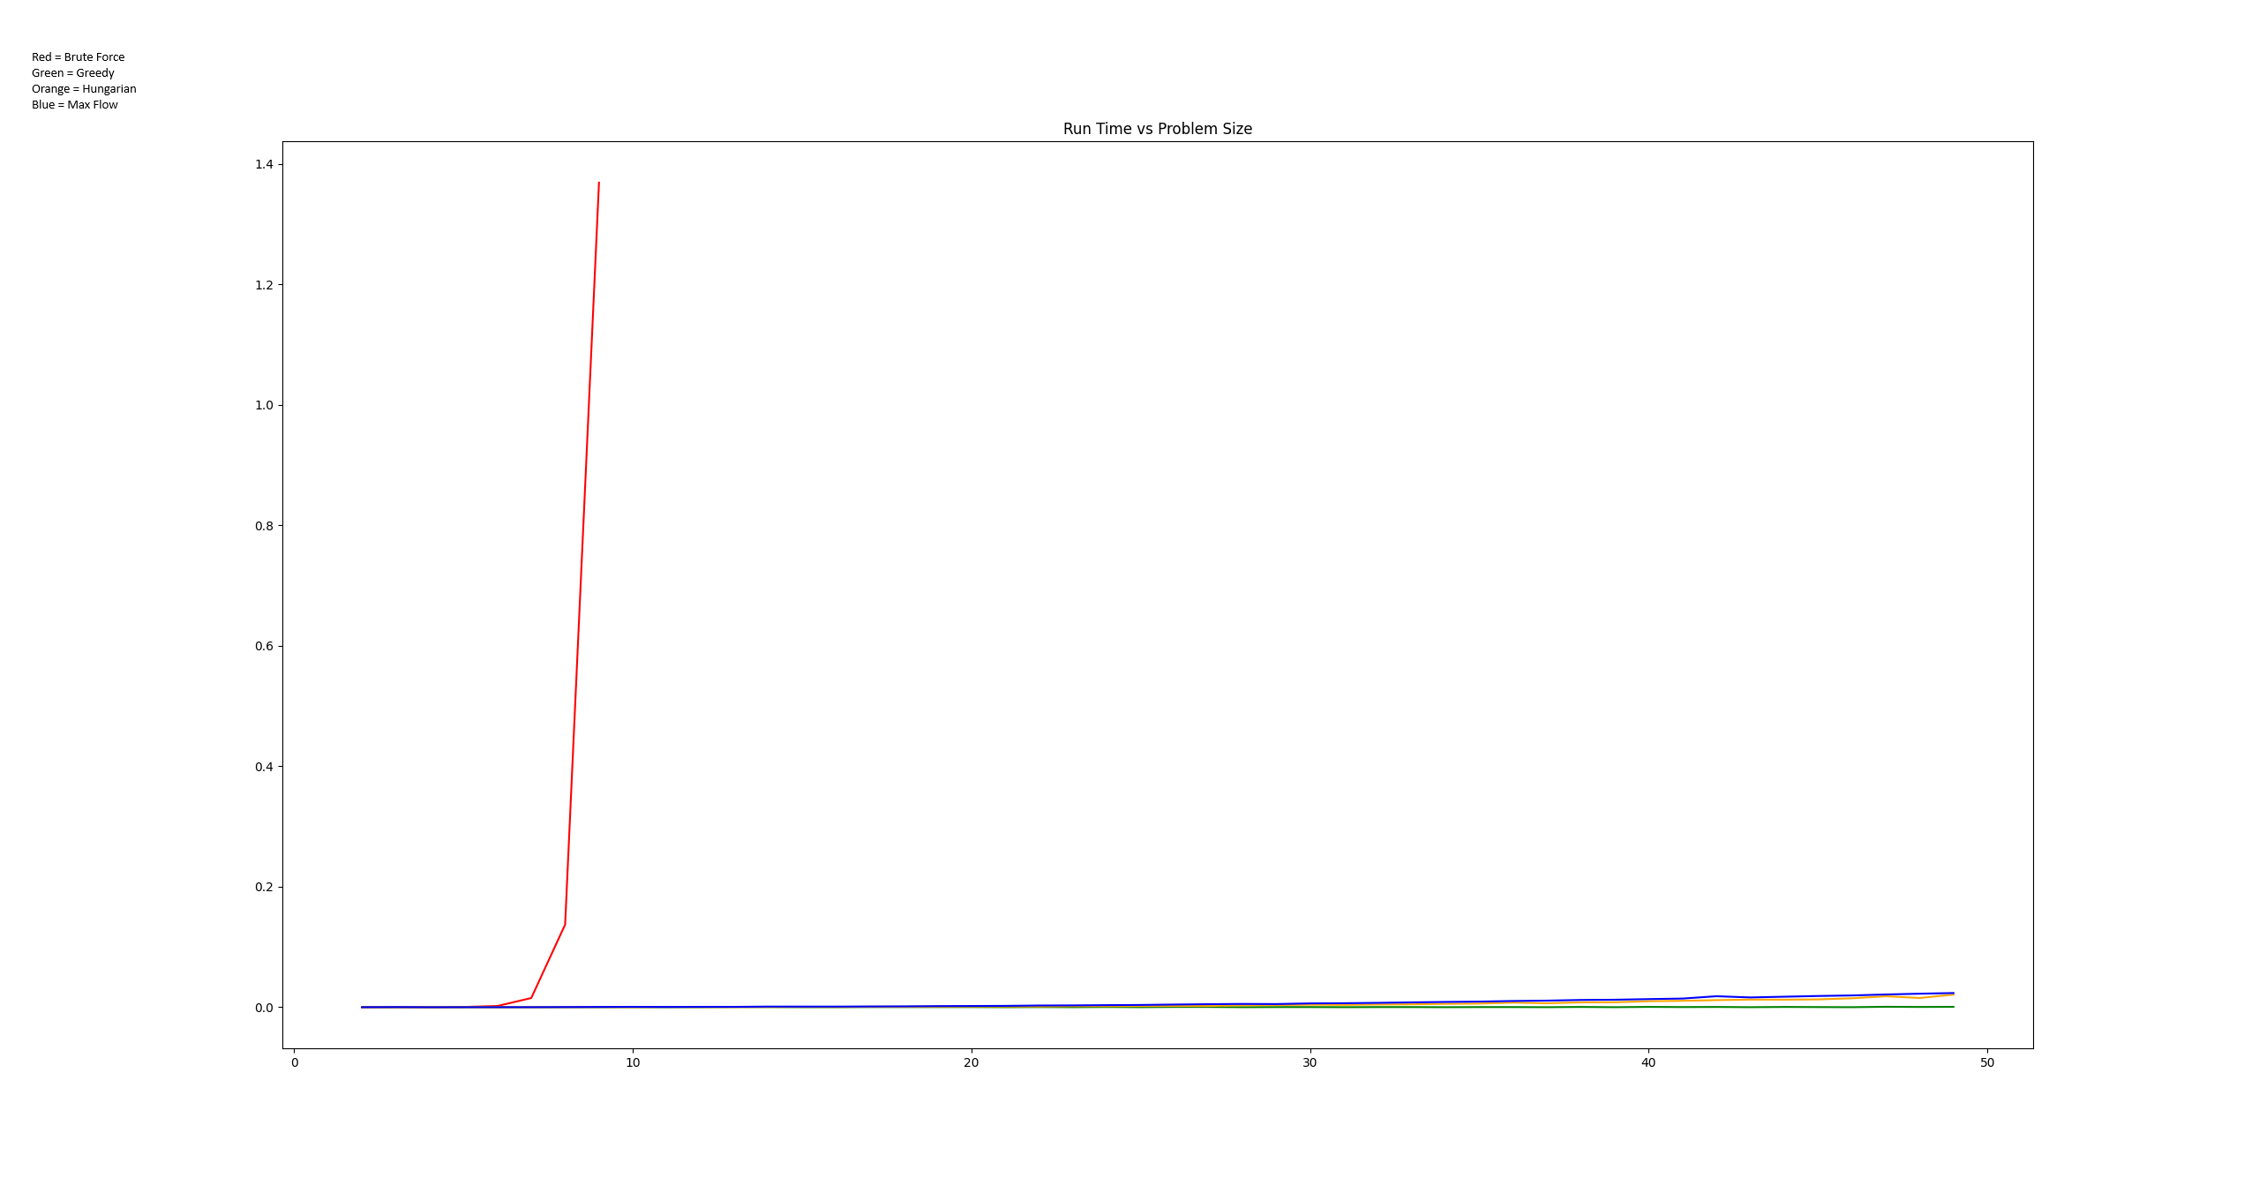
Our Results Running Time With Brute Force
From the chart we can see that the Brute Force algorithm with its O(n!) running time is so inefficient that it makes it hard to compare the other algorithms

Slide 10
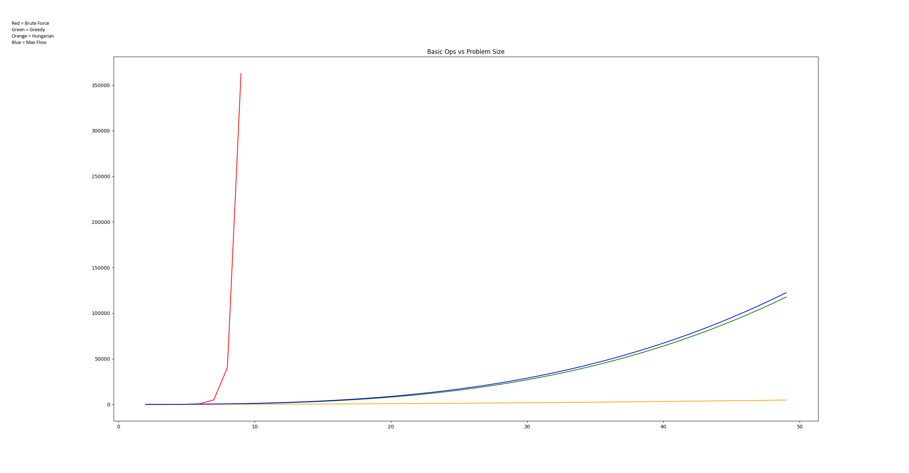
Our Results Basic Op Count With Brute Force
Again, Brute Forces inefficiency makes it difficult to compare the other algorithms.

Slide 11
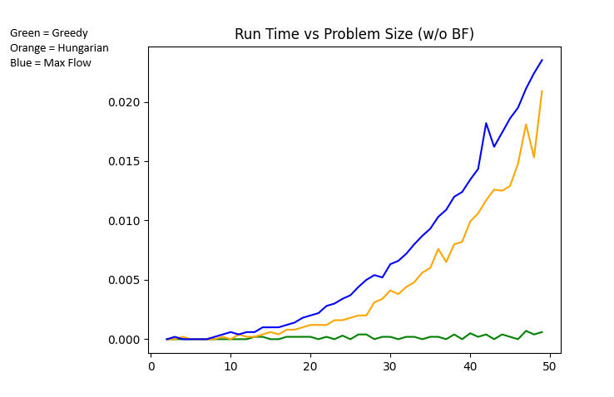
Our Results without Brute Force
Without the Brute Force Algorithm we can more clearly compare the other three algorithms. In these charts you can see that in terms of run time we found that the Hungarian and Max Flow algorithms perform similarly while the Greedy algorithm runs faster which is in line with our expectations.

Slide 12
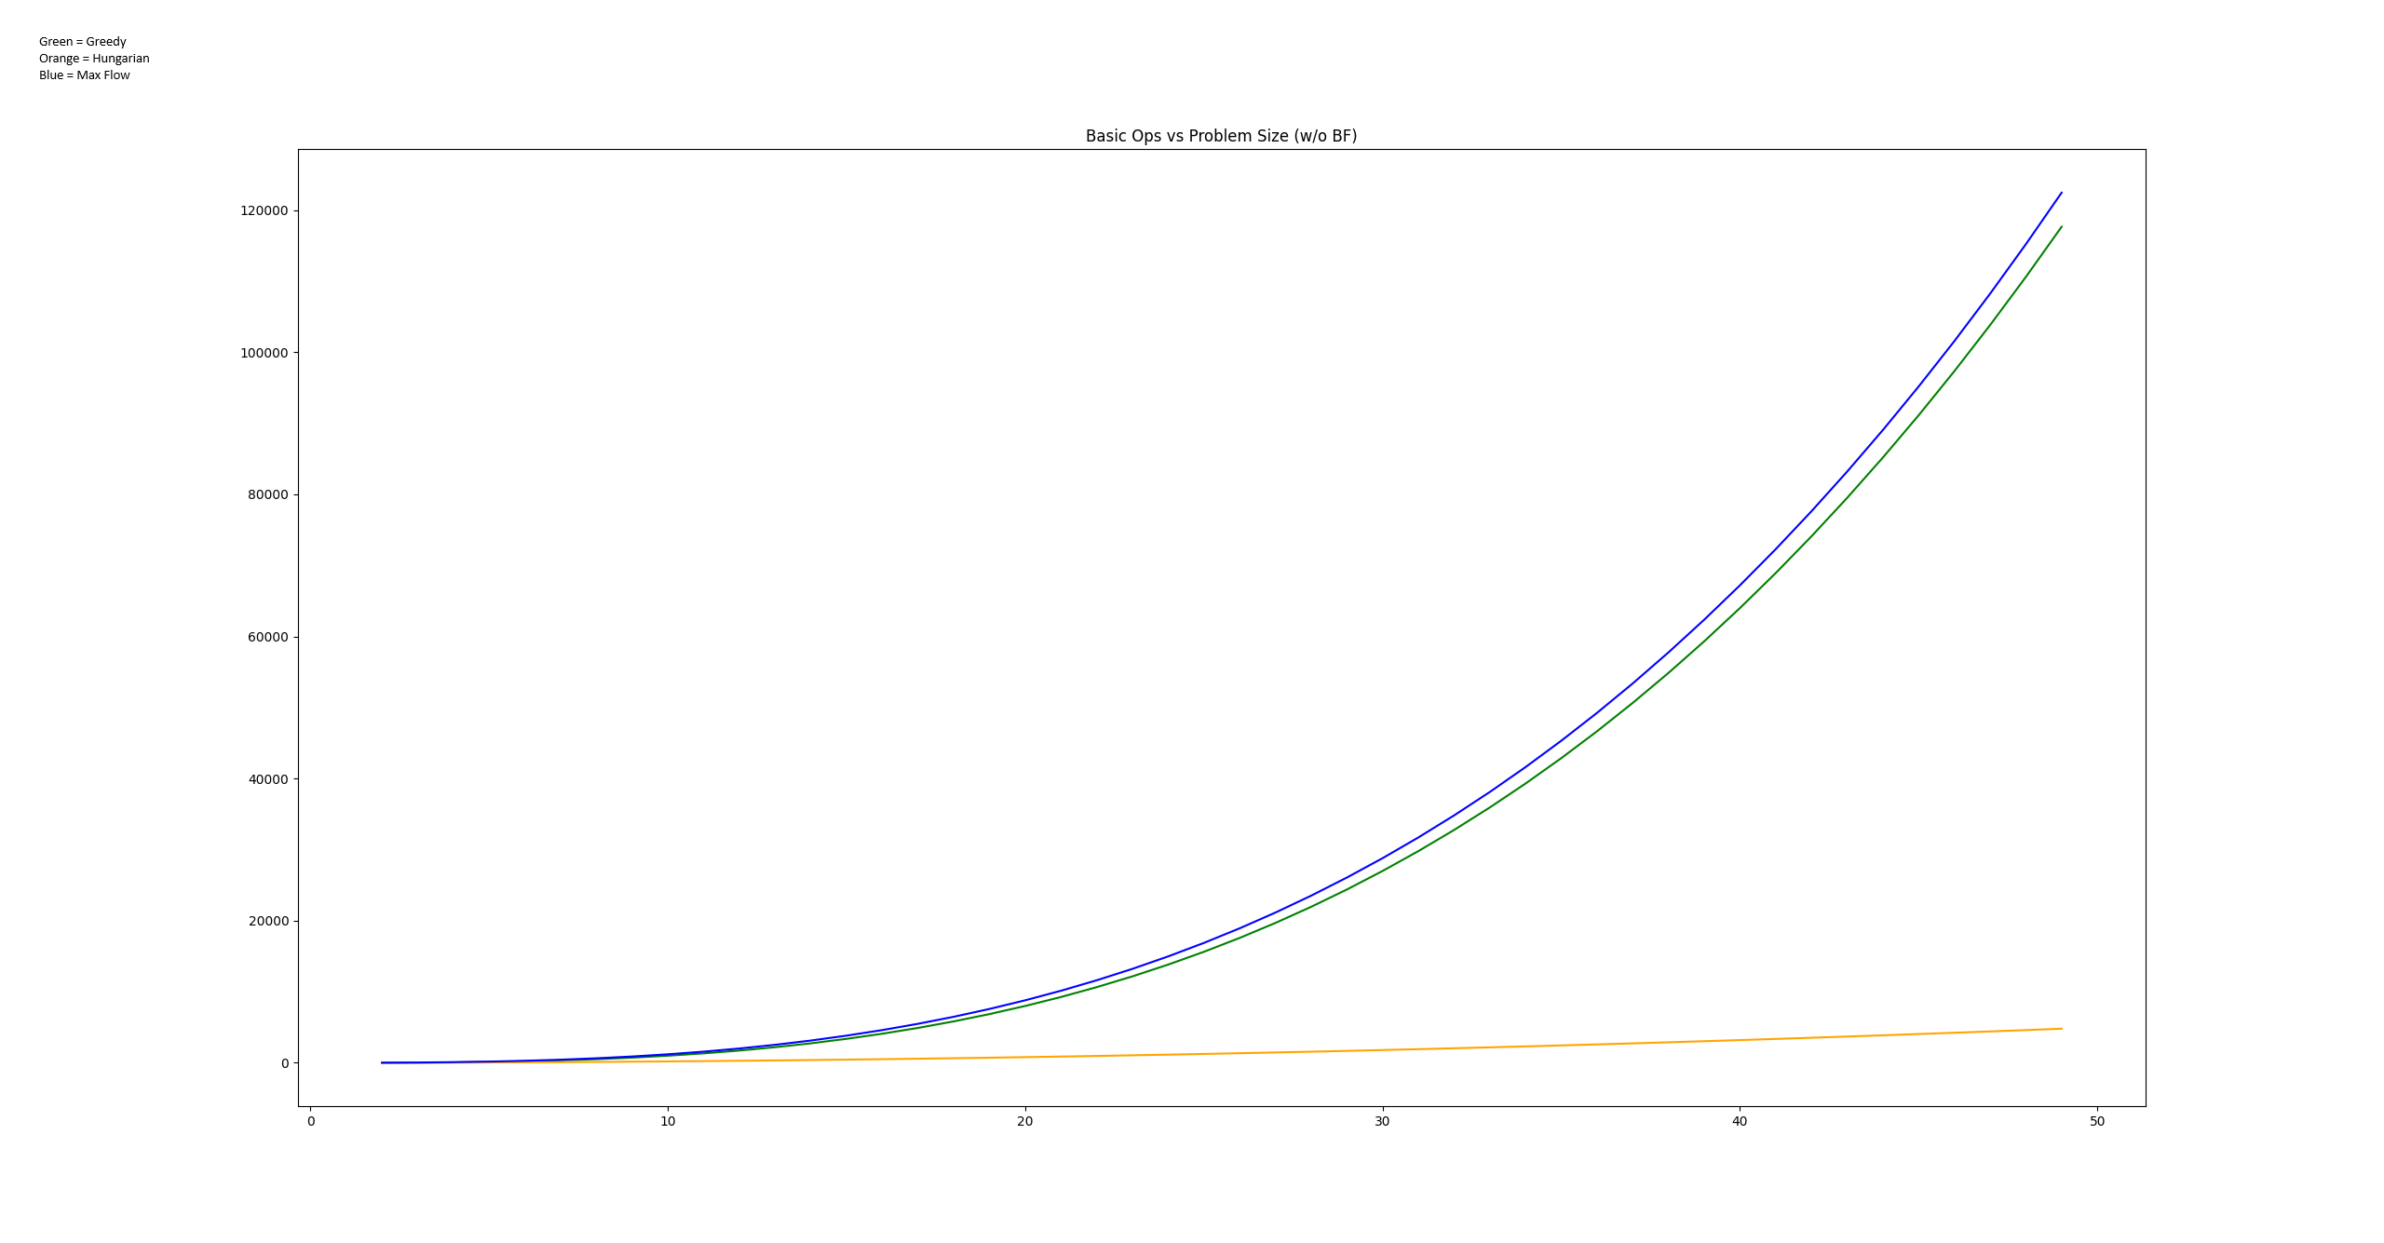
Our Results Basic Op Count without Brute Force
In terms of basic ops meanwhile we found that the Max Flow and Greedy algorithms have a similar growth rate while the Hungarian algorithm had the least amount of growth in terms of the number of basic operations.

Slide 13
Conclusion
In conclusion, we found that the many algorithmic solutions to the Assignment Problem have many pros and cons. We found that the Brute Force solution is extremely inefficient and shouldn’t be used outside of very specific circumstances. We also found that while the Greedy solution is efficient the fact that it can provide suboptimal solutions means that the applications it can be used for are limited. Finally, we found that the Hungarian and Max Flow solutions provide the best balance between efficiency and being able to provide optimal solutions consistently. While both have a running time of O(n^3) the Hungarian Algorithm provides that solution with fewer basic operations which makes that algorithm the best solution to the Assignment Problem.

Slide 14
Sources
https://www.topcoder.com/thrive/articles/Assignment%20Problem%20and%20Hungarian%20Algorithm
https://arxiv.org/html/2506.04274v1
https://www.thinkautonomous.ai/blog/hungarian-algorithm/
https://towardsdatascience.com/optimum-assignment-and-the-hungarian-algorithm-8b1027628028/

